Slide 1


Analysing the Impact of
Artificial Intelligence: Digital Media
Presented By,
Rohini Suresh

Slide 2

INTRODUCTION
Artificial Intelligence is rapidly evolving, promising revolutionary changes in technology and everyday life for all.
The rapid expansion of digital media platforms has resulted in exponential growth in content creation and consumption.
Handling large volume of digital content manually has become complex and time-consuming.
Artificial Intelligence (AI) enables automation, personalization and real-time analysis in digital media.
AI adoption has significantly contributed to increased revenue and productivity across media industries.
Along with growth, AI also introduces workforce transformation and human-AI collaboration.

Slide 3
OBJECTIVES
To present a comprehensive analytical assessment of the role of Artificial Intelligence in the digital media ecosystem.
To examine global and industry-level AI adoption patterns to identify key trends over time and to evaluate the economic impact of AI integration, with specific emphasis on revenue growth and AI-generated content volume.
To analyze the workforce implication of AI adoption, including job displacement and the evolution of human-AI collaboration.
To assess the competitive landscape of AI technologies by examining market share trends of leading AI companies.
To identify the most widely adopted AI tools influencing digital media production and distribution.
To provide strategic insights that support better decision-making

Slide 4
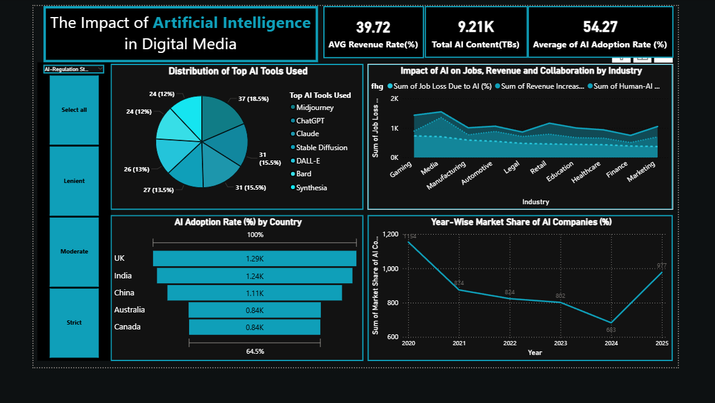
DASHBOARD

Slide 5
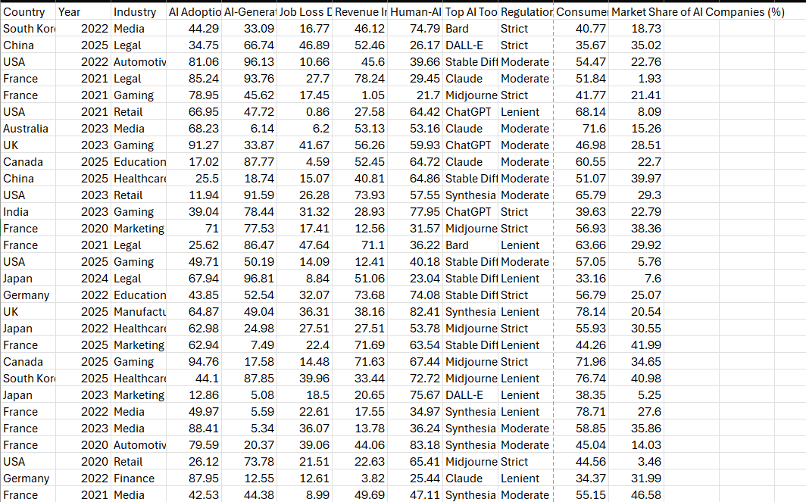
DATASET USED

Slide 6
CRITERIA USED
AI adoption rate
AI generated content volume
Revenue increase due to AI
Human-AI collaboration rate
Tool popularity index
AI regulation level
Year-wise growth
Market share of AI companies
Regulatory impact sensitivity
Workforce Transformation rate

Slide 7
CONCLUSION
The dashboard was created using a structured and systematic data-analysis in power BI.
This dashboard demonstrates that Artificial Intelligence is a transformative force in digital media, reshaping employment structures, and generating measurable economic value.
The relevant columns such as country, year, industry, AI adoption rate, revenue rate, top AI tools used, market share o AI companies, regulation status, consumer trust, job loss due to AI, Human AI- collaboration rate and AI -generated content volume.
Appropriate charts types were chosen based on the nature of the data, they are pie chart, staked area chart, funnel, line chart, cards created using DAX and slicers.
Overall, the dashboard highlights how AI is adopted across countries and indusries, its impact on revenue, jobs and content creation and the role of regulation and AI tolls in shaping digital media growth.

Slide 8
SUGGESTIONS
Increase transparency in AI algorithms to build user trust.
Limit over-automation to preserve human creativity and originality.
Strengthen misinformation detection systems to counter fake and manipulated media.
Introduce AI bias audits to ensure fairness in automated media outputs.
Mitigating AI drawbacks in digital media requires ethical governance, transparency, workforce, adaptation and responsible technological innovations.

Slide 9

REFERENCE
Kaggle : The Impact of AI in Digital Media
https://www.kaggle.com
Microsoft Excel

